Slide 1
HCI PROJECT
E-ticketing platform for intra city bus commuters
Keerthana Mahadev PES1201800768
Sowmya Prasad PES1201800172
Eshwar PES1201801487
Pooja S PES1201802464

Slide 2
PROBLEM STATEMENT
E-ticketing platform for intra city bus commuters

Slide 3
NEED FINDING
Observation : target customers put into 5 categories
Environmentalists
College/school students
Occasional commuters
Tech savvy commuters
Other daily bus commuters
Interviews: summary of 2 interviews
Interview 1 : college student + environmentalist
Interview 2 : new commuter in the city

Slide 4
NEED FINDING
Problems to solve:
Need for cash/exact change
Littering of streets and use of BPA
Losing tickets and getting fined
RECIBO:
Offers digital means of ticket Issue/Confirmation
Allows cashless transactions,
Maintains a record of their travel history and last but not the least
It’s environment friendly

Slide 5
Low-Fidelity Prototype

Slide 6
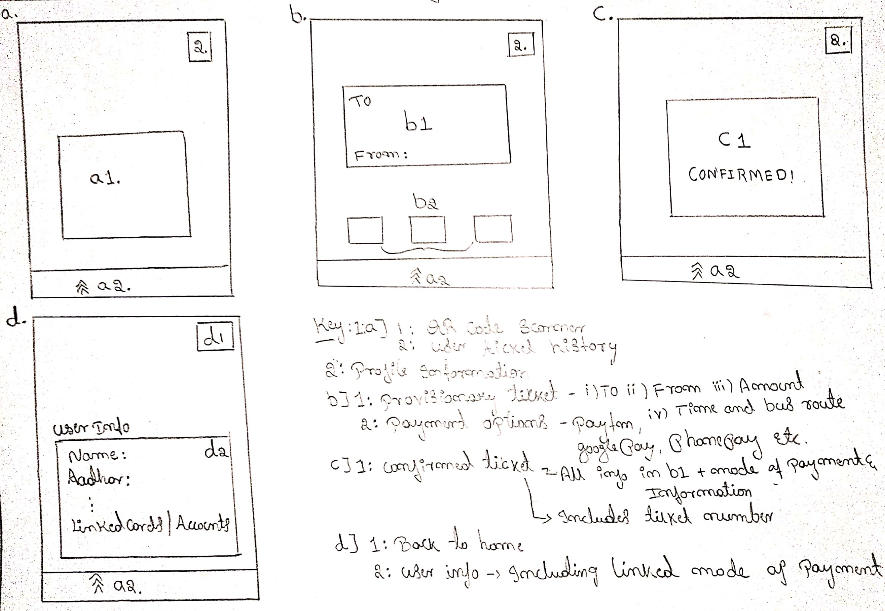
Passenger-1

Slide 7
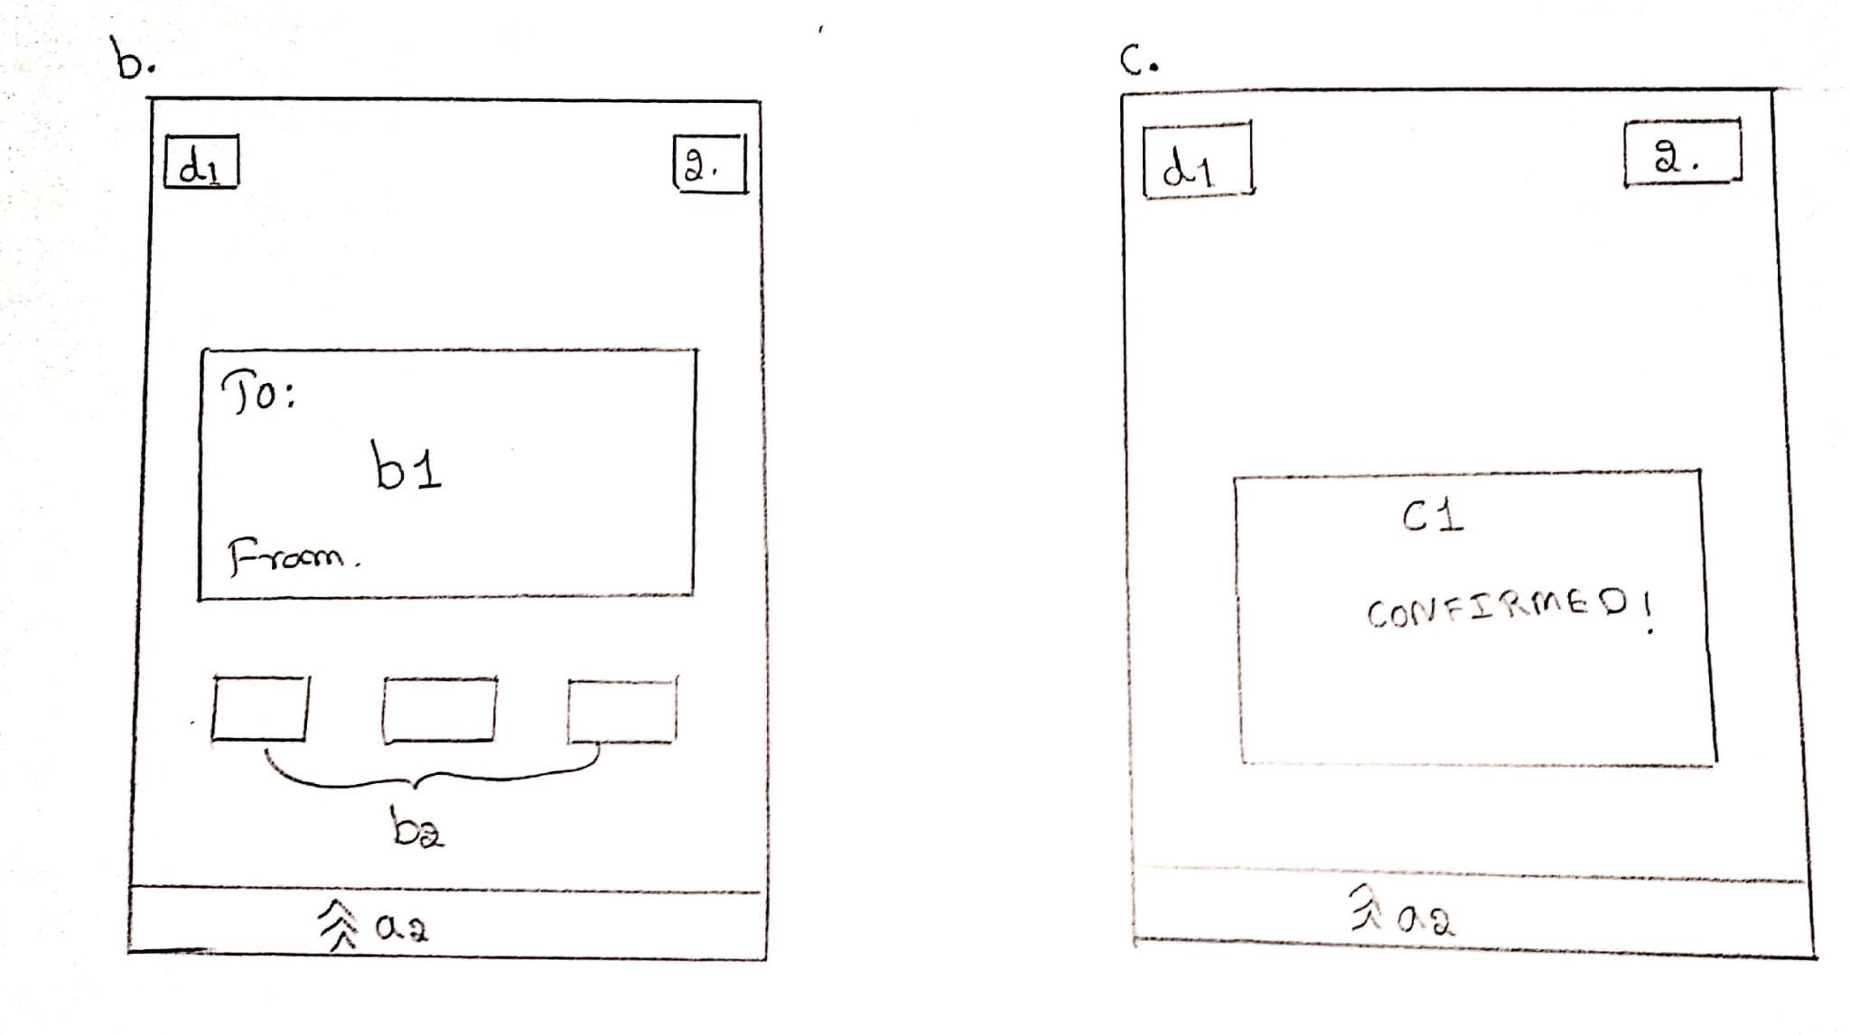
Passenger-2

Slide 8
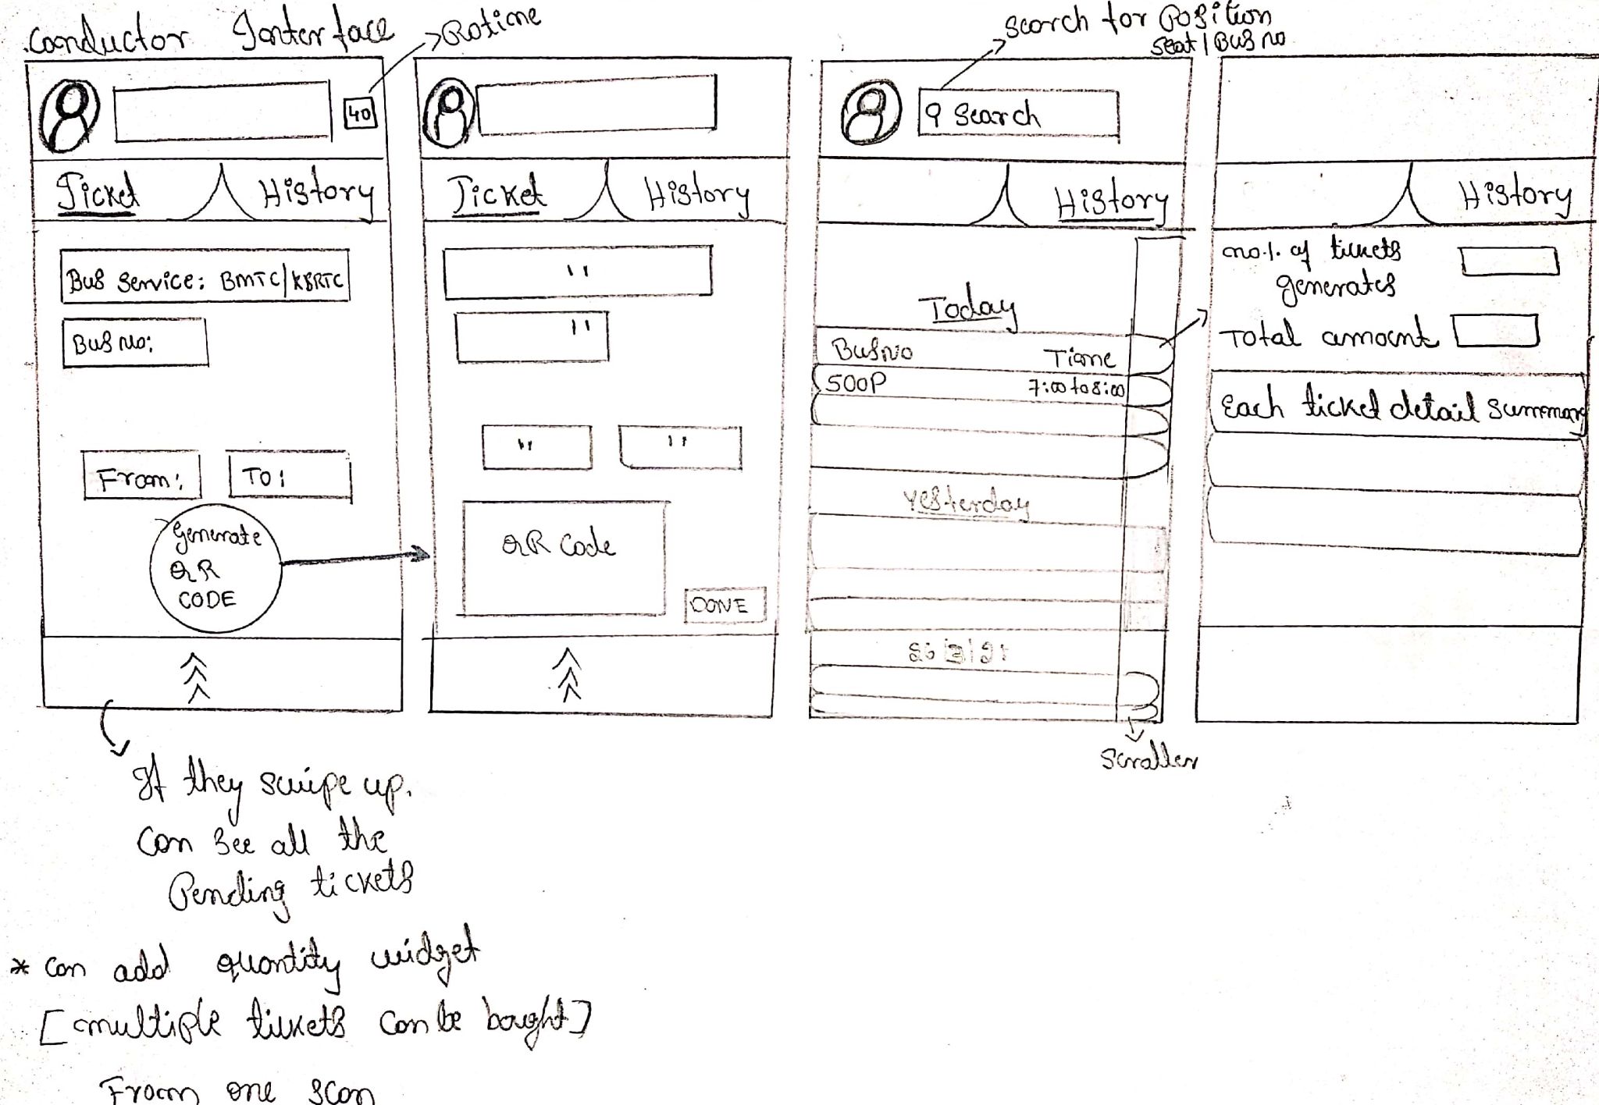
Conductor-1

Slide 9
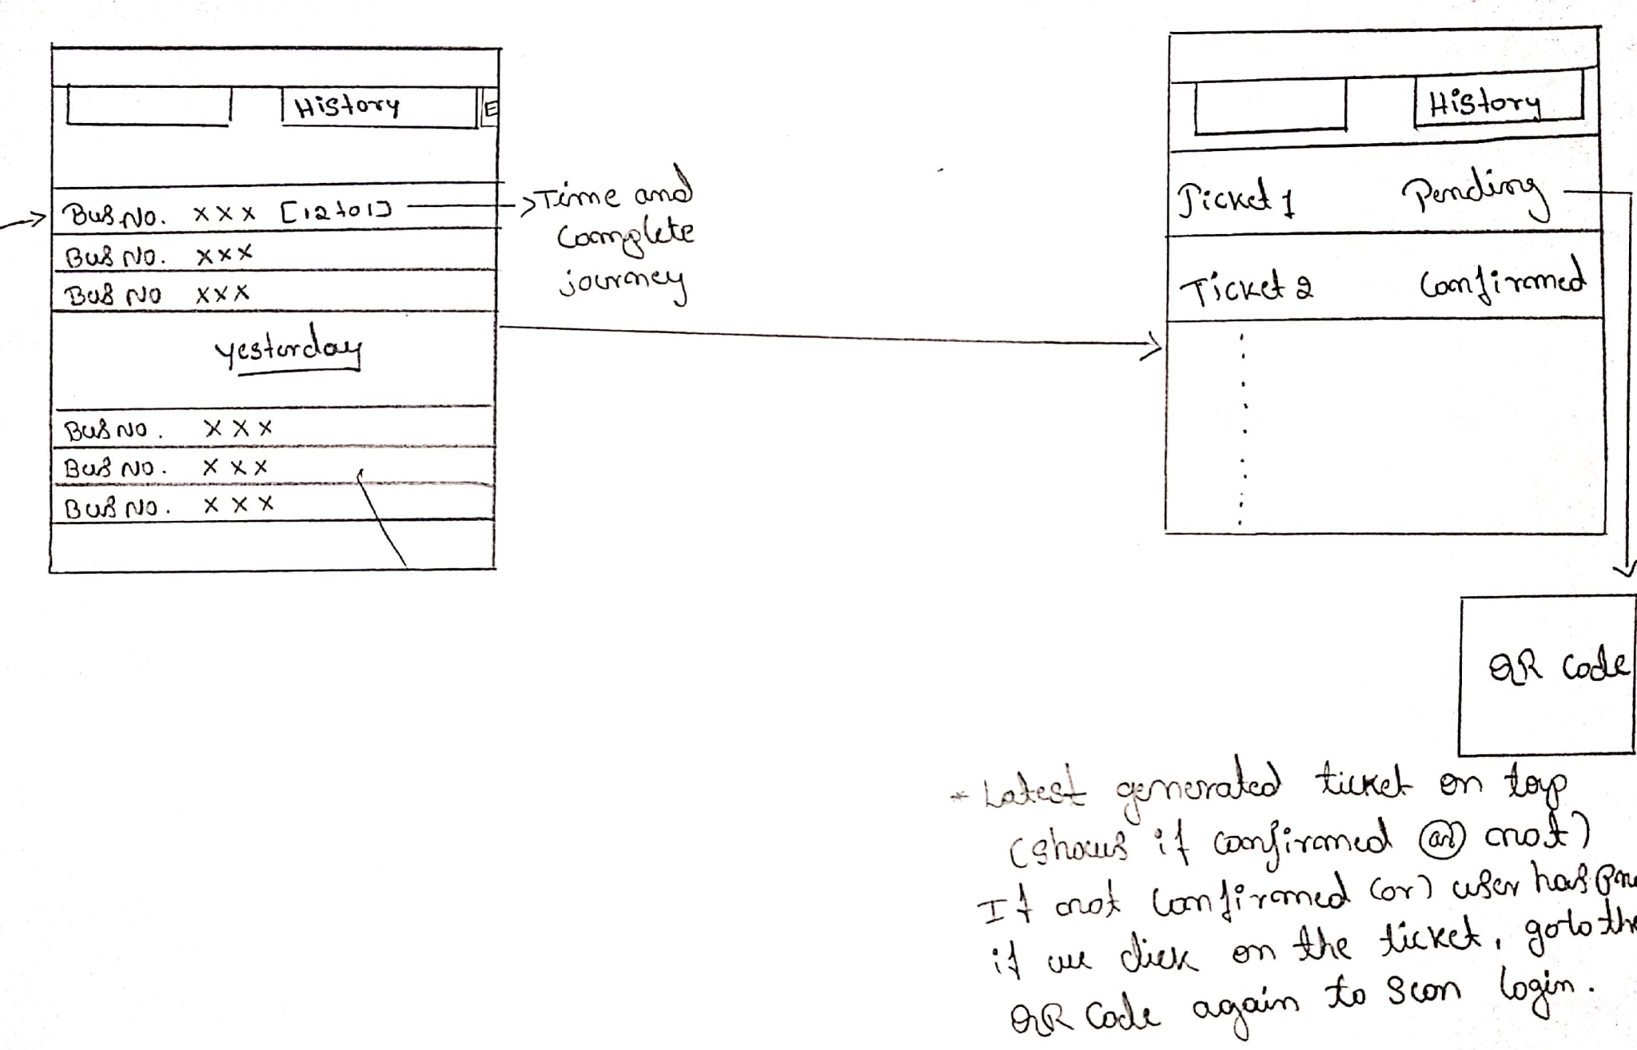
Conductor-2

Slide 10
High Fidelity Prototype
Figma Protoypes
Passenger
Conductor

Slide 11
Heuristics Evaluation
Intra city e ticketing design is acceptable along the lines of
Nielsen-Molich heuristics.
1.Keep users informed about its status appropriately and promptly.
The system interface promptly provides alerts for both the passenger and conductor interfaces.
Passenger:Alerts on
1.Tracking of user location.
2.Payment
1.Payment initiated.
2.Payment processing.
3.Payment confirmed.
3.Ticket issued alert sms.
Conductor:
1.Can access travel history.
2.Generate qr code.
3.Gets application alert when money is paid.

Slide 12
Heuristics Evaluation
Intra city e ticketing design is acceptable along the lines of
Nielsen-Molich heuristics.
2.Show information in ways users understand from how the real world operates, and in the users’ language.
1.The interface is extremely intuitive.
2.The workflow of the system resembles the real world events that take place while buying a ticket.
3.Offer users control and let them undo errors easily.
1.Users can easily change the location entered.
2.Users can back out of the process until the point of payment processing.
3.Conductors do not have and critical undo needs since the process of ticket issuing is message is automated.

Slide 13
Heuristics Evaluation
Intra city e ticketing design is acceptable along the lines of
Nielsen-Molich heuristics.
4.Be consistent so users aren’t confused over what different words, icons, etc. mean.
1.Our interface is clean with a minimalistic design, enhancing usability.
2.Icons for both the interfaces(user and conductor) is consistent.
5.Prevent errors – a system should either avoid conditions where errors arise or warn users before they take risky actions
1.Our system is designed to handle errors ,during critical flows such as payment processing.
2.Users are not allowed to back out while the payment is being processed.
3.Users are alerted promptly before proceeding to payment, with the destination address and amount to be payed.

Slide 14
Heuristics Evaluation
Intra city e ticketing design is acceptable along the lines of
Nielsen-Molich heuristics.
6.Have visible information, instructions, etc. to let users recognize options, actions, etc.
Our system does not force users to rely on memory.Every action is duly labeled.
7.Be flexible
Our system enables more experienced users to find faster ways to attain goals.
As such our system is the most efficient representation of the workflows.
8.Have no clutter
Our system contains only relevant information for current tasks.

Slide 15
Heuristics Evaluation
Intra city e ticketing design is acceptable along the lines of Nielsen-Molich heurs.
9. Provide plain-language help
Error messages and help is in plain english.
10.List concise steps in lean, searchable documentation.
Actions
1.User
a.User login (one time)
a.1.enter credentials
a.2.link payment gateway
b.Enter destination.
c.decide mode of payment.
b.1.Cash -Scan QR code from conductor interface.
b.2.Cashles -validate the payment (security check)
d.Payment confirmation alert received.
e.Ticket is received through sms, alert on app.
f.User travel details updated.
2.Conductor (one time)
a.Login to conductor interface
b.mode of payment.
b.1.Cash b.1.1.Generate QR code
b.1.2confirm payment and generate ticket
b.2.Cashles -do nothing
b.3.Commuter details updated on conductors interface.

Slide 16
Heuristics Evaluation
Intra city e ticketing design is acceptable along the lines of
Nielsen-Molich heuristics.
9. Provide plain-language help
Error messages and help is in plain english.
10.List concise steps in lean, searchable documentation.
Actions
.2.Conductor (one time)
a.Login to conductor interface
b.mode of payment.
b.1.Cash b.1.1.Generate QR code
b.1.2confirm payment and generate ticket
b.2.Cashles -do nothing
b.3.Commuter details updated on conductors interface.

